Slide 1

Blockchain
Sunitha R
Department of Computer Science and Engineering

Slide 2

Blockchain
SMART CONTRACT: CREATING AND DEPLOYING SC
Sunitha R
Department of Computer Science and Engineering

Slide 3
Blockchain
GOALS
Removal of manual intervention and oversight
eg. from legal counsel
Reduction in associated legal costs, fees and process (time) speed of contract creation and execution
Automated transfer of funds via computer recognizable/definable events
Flexibility in contract

Slide 4
Blockchain
TYPES OF SMART CONTRACT
Deterministic
Non-deterministic

Slide 5
Blockchain
CREATE AND DEPLOY THE SMART CONTRACT
STEPS:
Understand the use-case of smart contract.
create a basic architecture of smart contracts interaction or flowchart how functions will interact with each other.
Start development using any IDE or development tools like Truffle, remix with proper documentation of each and every function.
Once the development is completed start testing smart contracts on test-net or private blockchain.(this is called a manual testing).
Record all the transaction while testing on test-net, analyze results of all transactions with actual use case or business logic of smart contract.

Slide 6
Blockchain
CREATE AND DEPLOY THE SMART CONTRACT
Unit testing will be the next step in smart contract development life cycle, there are multiple frameworks for unit and integration testing that can be use to test smart contract. Example : Truffle framework.
Once unit testing is done using truffle framework on ganache, smart contract author should go for 3rd party Audit of smart contract.
Last but not the least, bug bounty programs are also very efficient to secure smart contracts.

Slide 7
Blockchain
Blockchain Networks Using Smart Contracts
Bitcoin
Ethereum

Slide 8
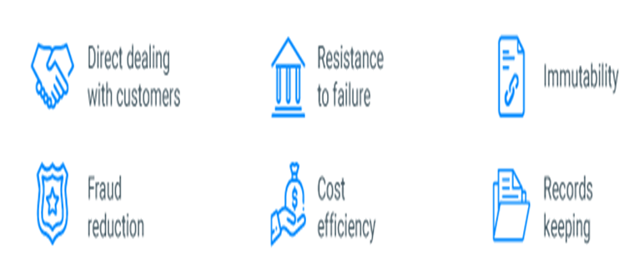
Blockchain
ADVANTAGEOUS OF SMART CONTRACTS

Slide 9
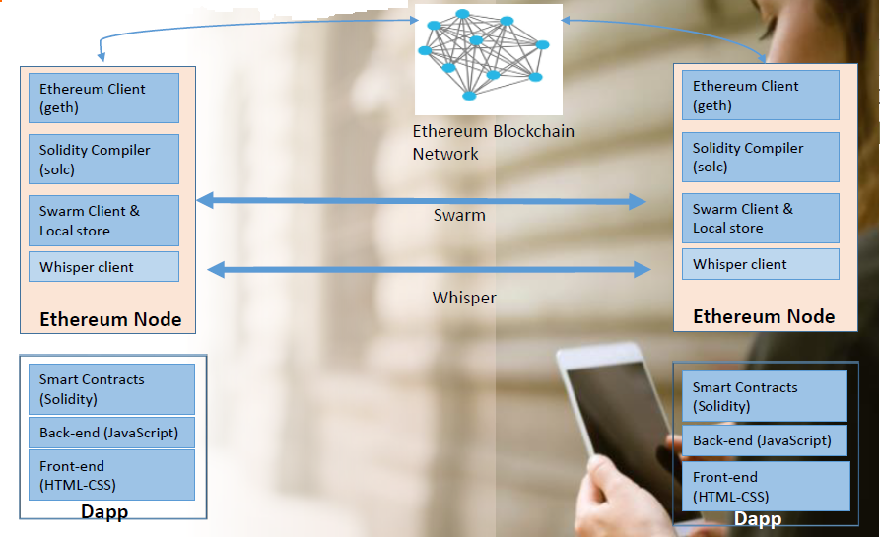
Blockchain
ETHEREUM BLOCKCHAIN COMPONENTS

Slide 10
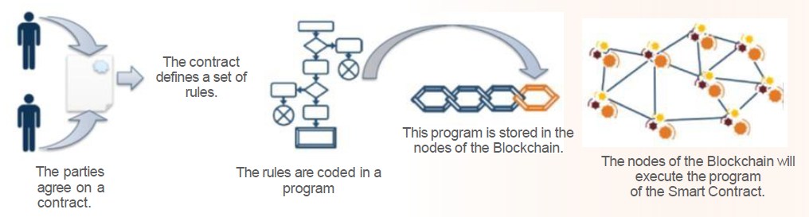
Blockchain
SMART CONTRACTS CAN AUTOMATIZE EXECUTION OF TRANSACTIONS

Slide 11
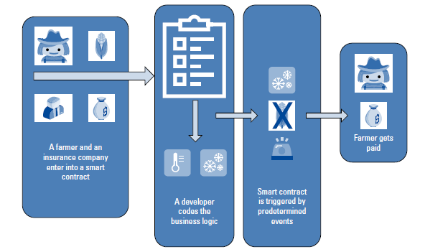
Blockchain
EXAMPLE- FARMING SMART CONTRACT

Slide 12
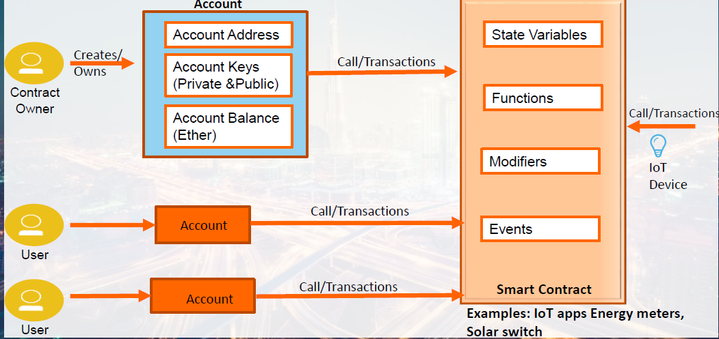
Blockchain
USE CASE: SMART SWITCH CONTRACT IOT

Slide 13
Blockchain
SUPPLEMENTARY READINGS
https://ethereum.org/en/developers/docs/smart-contracts/
https://www.ibm.com/blogs/blockchain/2018/07/what-are-smart-contracts-on-blockchain/

Slide 14
THANK YOU
Prof.Sunitha R
Department of Computer Science and Engineering
sunithar@pes.edu

